Slide 1
CS 300 HOMEWORK 5 by Berna YILDIRAN 26431

Slide 2
QUESTION #1 Dijkstra’s​ Weighted ​ Shortest Path Algorithm

Slide 3
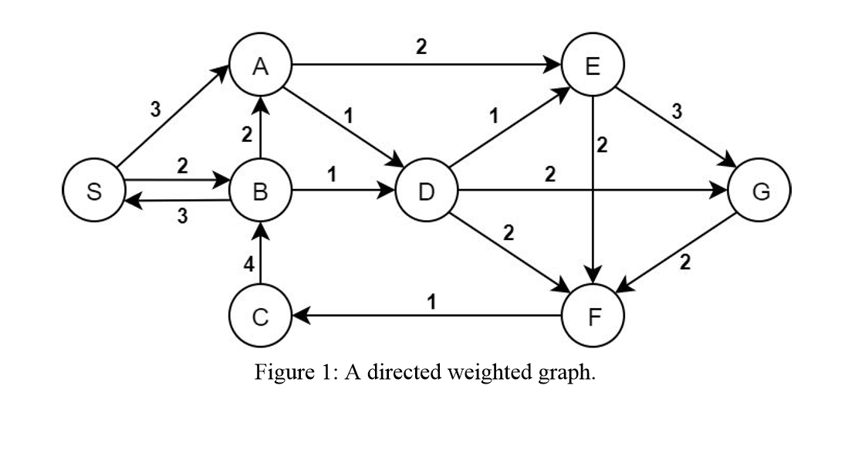
3 ( S)
∞ ( ?)
2 ( S)
0 ( S)
∞ ( ?)
∞ ( ?)
∞ ( ?)
∞ ( ?)

Slide 4
3 ( S)
∞ ( ?)
2 ( S)
0 ( S)
∞ ( ?)
∞ ( ?)
∞ ( ?)
∞ ( ?)

Slide 5
4( B)
∞ ( ?)
2 ( S)
0 ( S)
3 ( B)
∞ ( ?)
∞ ( ?)
∞ ( ?)

Slide 6
3( S)
∞ ( ?)
2 ( S)
0 ( S)
3 ( B)
∞ ( ?)
∞ ( ?)
∞ ( ?)

Slide 7
3( S)
4 ( D)
2 ( S)
0 ( S)
3 ( B)
5 ( D)
∞ ( ?)
5 ( D)

Slide 8
3( S)
4 ( D)
2 ( S)
0 ( S)
3 ( B)
5 ( D)
∞ ( ?)
5 ( D)

Slide 9
3( S)
4 ( D)
2 ( S)
0 ( S)
3 ( B)
7 ( E)
∞ ( ?)
6 ( E)

Slide 10
3( S)
4 ( D)
2 ( S)
0 ( S)
3 ( B)
5 ( D)
∞ ( ?)
5 ( D)

Slide 11
3( S)
4 ( D)
2 ( S)
0 ( S)
3 ( B)
5 ( D)
∞ ( ?)
5 ( D)

Slide 12
3( S)
4 ( D)
2 ( S)
0 ( S)
3 ( B)
5 ( D)
6 ( F)
5 ( D)

Slide 13
3( S)
4 ( D)
2 ( S)
0 ( S)
3 ( B)
5 ( D)
6 ( F)
5 ( D)

Slide 14
QUESTION #2 Prim’s Minimum Spanning Tree Algorithm

Slide 15
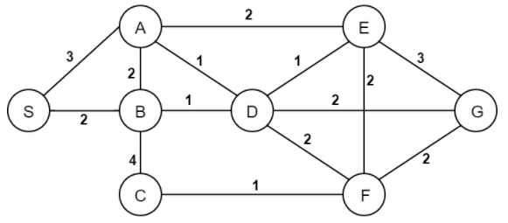
Visited ={S, }

Slide 16
Visited ={S, B, }

Slide 17
Visited ={S, B, D, }

Slide 18
Visited ={S, B, D, E, }

Slide 19
Visited ={S, B, D, E, }

Slide 20
Visited ={S, B, D, E, A, }

Slide 21
Visited ={S, B, D, E, A, F, }

Slide 22
Visited ={S, B, D, E, A, F, }

Slide 23
Visited ={S, B, D, E, A, F, C, }

Slide 24
Visited ={S, B, D, E, A, F, C, G}

Slide 25
QUESTION #3 Kruskal’s Minimum Spanning Tree Algorithm

Slide 26
Visited ={B, D }

Slide 27
Visited ={B, D , F, C, }

Slide 28
Visited ={B, D, F, C, E, }

Slide 29
Visited ={B, D, F, C, E, A, }

Slide 30
Visited ={B, D, F, C, E, A, }

Slide 31
Visited ={B, D, F, C, E, A, G, }

Slide 32
Visited ={B, D, F, C, E, A, G, }

Slide 33
Visited ={B, D, F, C, E, A, G, S, }

Slide 34
Visited ={B, D, F, C, E, A, G, S, }

Slide 35
QUESTION #4 Breadth-first Traversal

Slide 36
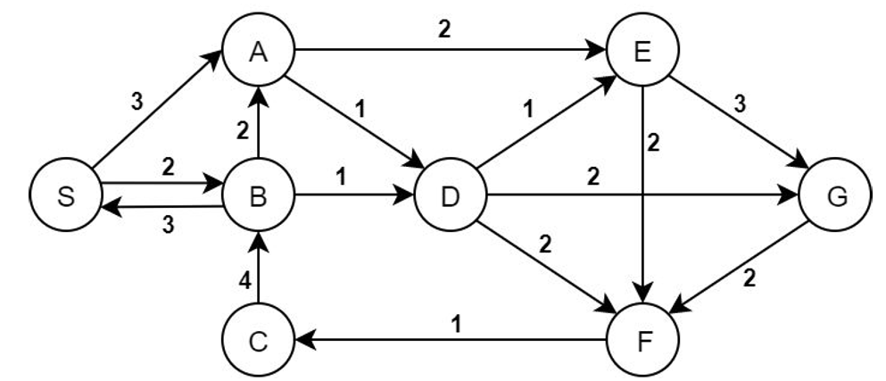
0

Slide 37
1
0
1

Slide 38
1
2
0
2
1

Slide 39
1
2
0
2
3
1
3

Slide 40
1
2
0
2
3
1
3
4

Slide 41
QUESTION #5 Depth-first Traversal

Slide 42
A

Slide 43
0
Visited ={ }

Slide 44
1
0
Visited ={ }

Slide 45
1
0
2
Visited ={ }

Slide 46
1
0
2
3
Visited ={ }

Slide 47
1
4
0
2
3
Visited ={ }

Slide 48
1
4
0
2
3
5
Visited ={ }

Slide 49
1
4
0
6
2
3
5
Visited ={ }

Slide 50
1
4
0
6
2
3
7
5
Visited ={ }

Slide 51
B

Slide 52
b) Give the post-order numbers for all the nodes.
C-F-G-E-D-B-A-S
1
7
1
4
4
0
8
6
3
2
6
5
3
1
2
7
5
Visited ={ }

Slide 53
C

Slide 54
c) Give the pre-order numbers for all the nodes.
S-B-D-F-C-E-G-A
1
1
8
6
4
1
0
6
7
2
3
2
3
7
5
5
4
Visited ={ }

Slide 55
D

Slide 56
d) List the tree arcs, cross arcs, forward arcs, and backward arcs.
Visited ={ }

Slide 57
QUESTION #6 Topological Ordering

Slide 58
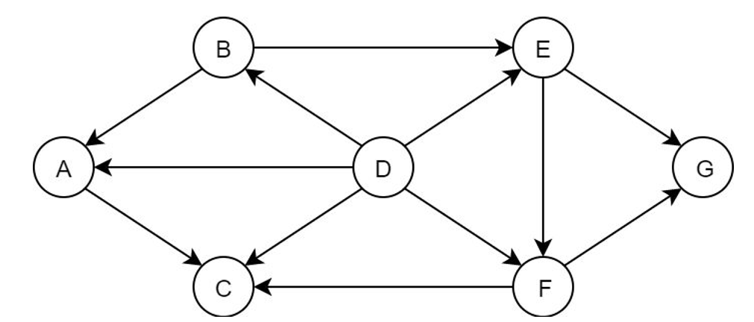
Sorted = {D, }

Slide 59
Sorted = {D, B, }

Slide 60
Sorted = {D, B, E, }

Slide 61
Sorted = {D, B, E, A, }

Slide 62
Sorted = {D, B, E, A, F, }

Slide 63
Sorted = {D, B, E, A, F, C, }

Slide 64
Sorted = {D, B, E, A, F, C, G}

